Slide 1
Next Generation Sync Client – The last chance for Microsoft
Hans Brender
Notes:
This slide is mandatory. Please do not remove.

Slide 2

Hans Brender
Cloud Ranger, MVP Office Servers and Services
BitTitan
https://hansbrender.wordpress.com/
https://twitter.com/HansBrender
“Mr.OneDrive”, Facebook, Xing, Linkedin, Yammer, …

Slide 3
Notes:
This slide is mandatory. Please do not remove and try to use it during Q&A at the end of your session. Thank you!

Slide 4



Synchronization Evolution
Groove
Peer to Peer
Sync over Firewall

Slide 5


Synchronization Evolution
SharePoint Workspace 2010

Slide 6


Synchronization Evolution
SkyDrive
private cloud storage
privately-related documents
managed by users
public cloud
SkyDrive Pro
employee cloud storage
Work-related documents
mangaed through IT
SharePoint Online and on-premises

Slide 7
Synchronization Evolution
OneDrive
private cloud storage
privately-related documents
managed by users
public cloud
OneDrive for Business
employee cloud storage
Work-related documents
managed through IT
SharePoint Online and on-premises

Slide 8








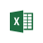


Architektur
Upload Center

Slide 9
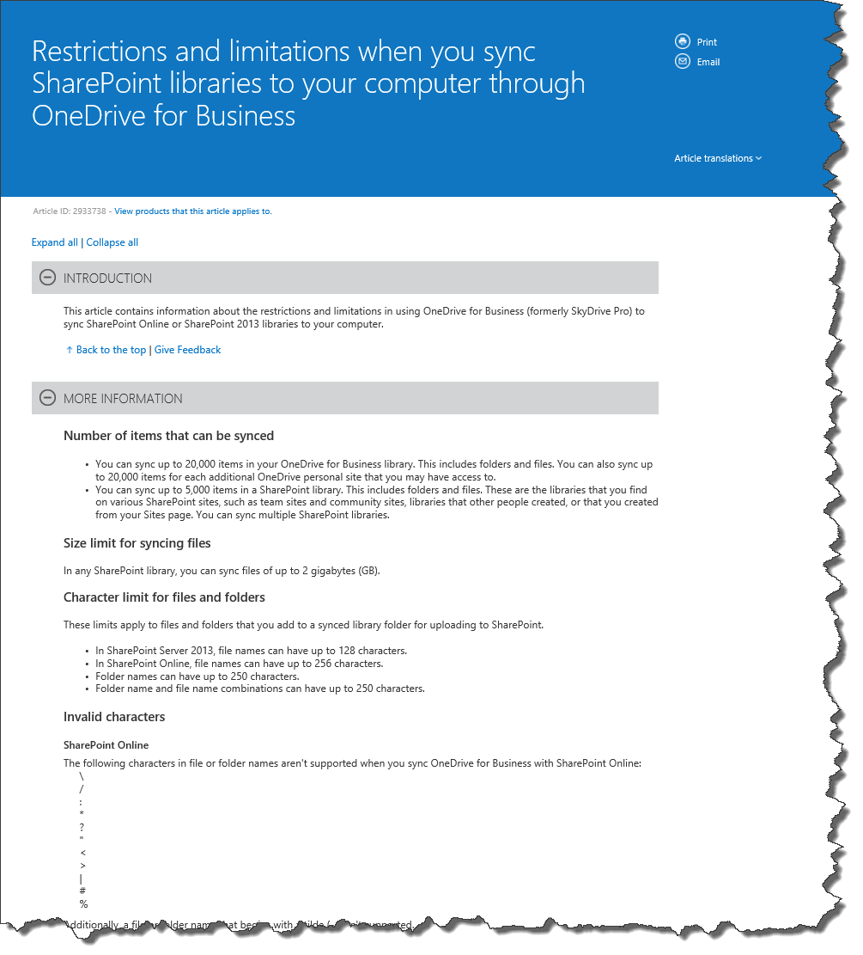
Synchronisation mit Groove
Limits SharePoint (Online)
20000 Elements per view, folder oder query
5000 Elements in SharePoint Team-sites
20000 Elements in Personal Sites
5 Million Element in one Library
Filename: 256 characters
Not valid characters # and %
Microsoft KB 2933738 http://bit.ly/1ATNAQb
TechNet: http://bit.ly/1cSk4Hq Microsoft Office: http://bit.ly/1dwpzjC

Slide 10
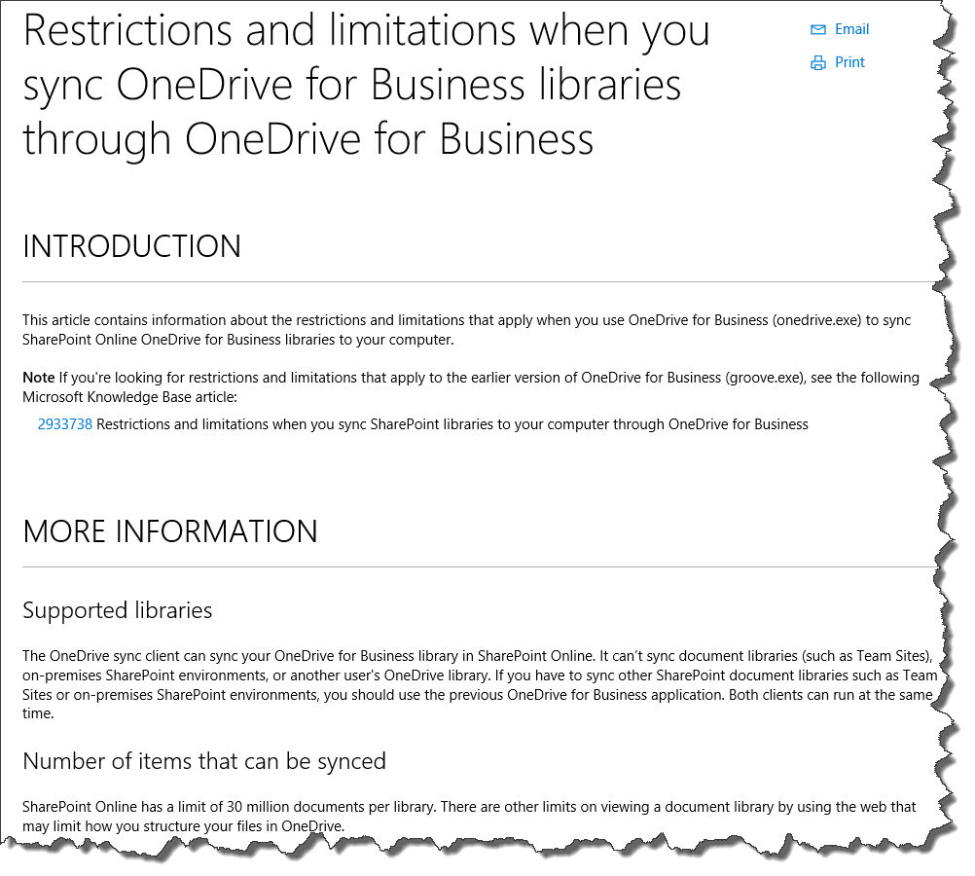
Synchronisation mit NGSC
Limits SharePoint (Online)
30 Million documents each library
File-Length: 10 GB
File-Name 256 characters
Not valid characters: # und %
Restrictions on several file extensions see KB
No Authenticated Proxies
No libraries with setting: CheckOut
No IRM libraries
Microsoft KB 315202 http://bit.ly/1PfGQfX

Slide 11
OneDrive for Business & Groups
Office 365
Exchange
OneDrive for Business
Hidden site collection

Slide 12
Next Generation Sync Client
August 2015
Dez. 2015
Q1 2016
Q2 2016
???
OneDrive
Personal
OneDrive for Business
Windows 8.1
SharePoint Team Sites & Groups
SharePoint
On Premise
Windows 10
The original Windows 10 GA date was …
Over 270 Mio Installations – W10 comes with NGSC (MS Account – OneDrive Personal)

Slide 13
Next Generation Sync Client
August 2015
Dez. 2015
Q1 2016
Q2 2016
???
OneDrive
Personal
OneDrive for Business
Windows 8.1
SharePoint Team Sites & Groups
SharePoint
On Premise
NGSC für OneDrive for Business freigegeben
Nur für Windows 7, 8.0, 10 und MAC OS X
Keine IRM Bibliotheken
Maximale Dateigröße: 10 GB
Die 20.000 Hürde entfällt

Slide 14
Next Generation Sync Client
August 2015
Dez. 2015
Q1 2016
Q2 2016
???
OneDrive
Personal
OneDrive for Business
Windows 8.1
SharePoint Team Sites & Groups
SharePoint
On Premise
NGSC for Windows 8.1
OneDrive (Personal) is integrated in Explorer (separate Sync Engine: SkyDrive.exe)
Since April 16 you may install Next Generation Sync Client to connect to One Drive for Business

Slide 15
Next Generation Sync Client
August 2015
Dez. 2015
Q1 2016
Q4 2016
???
OneDrive
Personal
OneDrive for Business
Windows 8.1
SharePoint Team Sites & Groups
SharePoint
On Premise
NGSC and SharePoint Team Sites + Groups planned
Functions to Share (with AD)

Slide 16
Next Generation Sync Client
August 2015
Dez. 2015
Q1 2016
Q2 2016
???
OneDrive
Personal
OneDrive for Business
Windows 8.1
SharePoint Team Sites & Groups
SharePoint
On Premise
Windows 10
Ursprünglich geplant….
Jetzt 200 Mio Installationen – kommt mit dem NGSC (MS Konto – OneDrive Personal)

Slide 17
Next Generation Sync Client
NGSC New Generation
Sync Client
Vista SP2
Windows 7
Windows 8.0
Windows 10.0
MAC
OSX 10.9
Windows Server 20008 R2
Requirements
Windows Server
2008 SP2
Windows Server
2012
Not available for Windows XP or Windows 8.1

Slide 18
Next Generation Sync Client
Operating System Windows 8.1
NGSC New Generation Sync Client
SharePoint Team Sites
Groups
OneDrive for Business
OneDrive
Personal
Synchronization with Groove.exe
Synchronization
with SkyDrive.exe

Slide 19
Next Generation Sync Client
Operating systems:
Vista SP2 , Windows 7,
Windows 8.0, Windows 10
MAC OS X10.9
NGSC New Generation Sync Client
SharePoint Team Sites
Groups
OneDrive for Business
OneDrive
Personal
Synchronization with Groove.exe

Slide 20
Next Generation Sync Client
The goal of Microsoft
until end of 2016
NGSC New Generation Sync Client
SharePoint Team Sites
Groups
OneDrive for Business
OneDrive
Personal

Slide 21
Next Generation Sync Client
SharePoint Team Sites
Groups
OneDrive for Business
OneDrive
Personal
synchronization with Groove.exe
synchronization
with Next Generation Sync Client

Slide 22
Next Generation Sync Client
SharePoint Team Sites
Groups
OneDrive for Business
OneDrive
Personal
Synchronization with Groove.exe
Synchronization with OneDrive

Slide 23
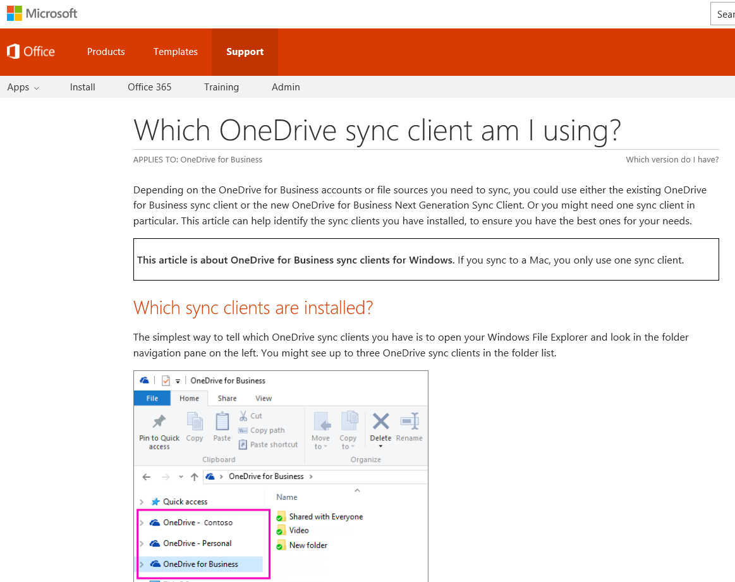
Next Generation Sync Client
Microsoft Office Support
Which OneDrive sync client am I using?

Slide 24
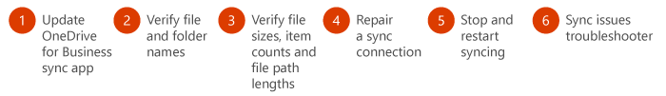
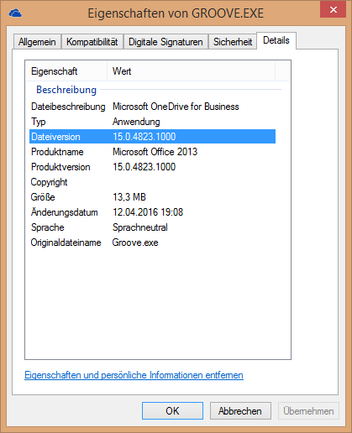
Next Generation Sync Client
Fix OneDrive for Business sync problems (Groove.exe)
6 steps to make you happy ☺
Step 1: Make sure that the OneDrive for Business sync app is up-to-date
Step 2: Make sure that your file and folder names don't contain unsupported characters or invalid file types
Step 3: Make sure that your file sizes, items counts, and file path lengths are within the limits
Step 4: Repair a OneDrive for Business sync connection
Step 5: Stop the sync and restart
Step 6: Use the OneDrive for Business Sync Issues Troubleshooting Guide
From Microsoft Office Support: Detailed information including Links

Slide 25
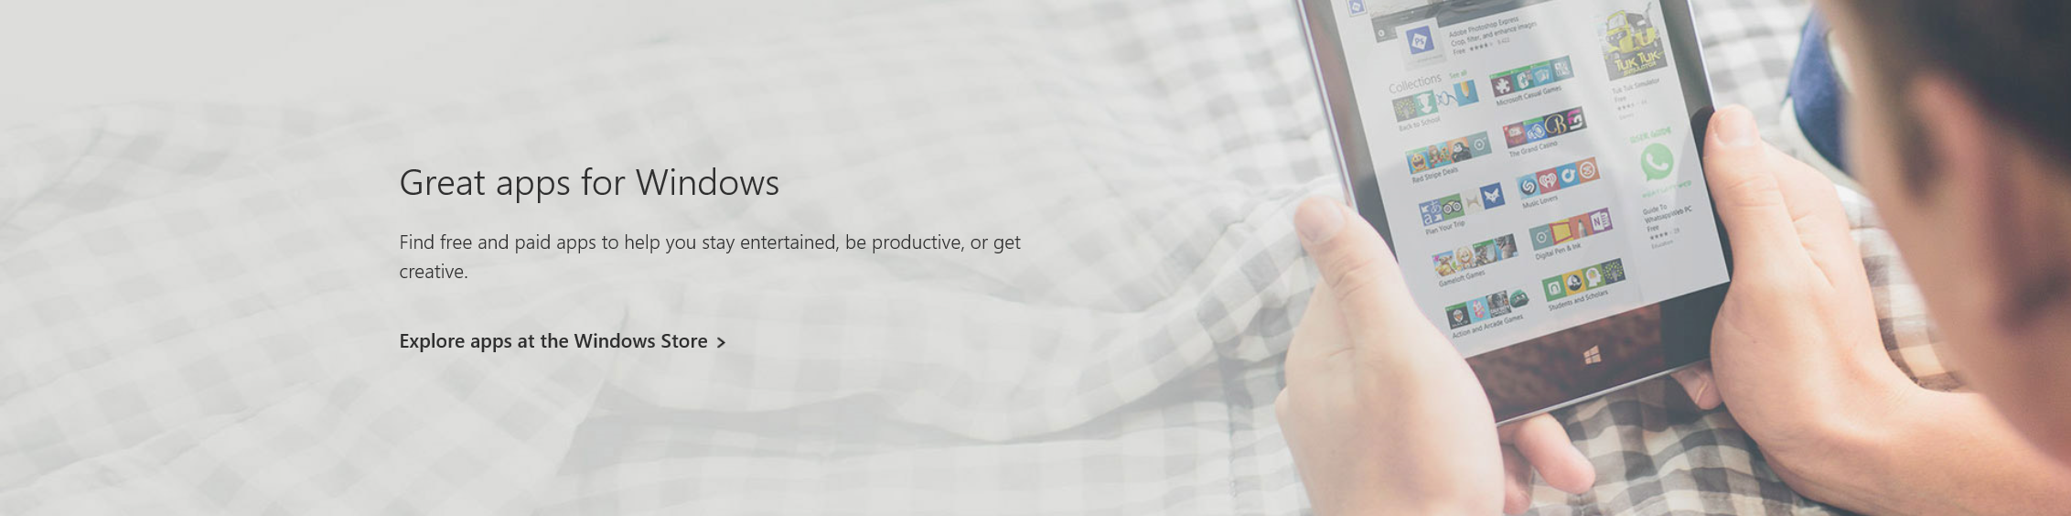
Next Generation Sync Client
Documents for the Next Generation Sync Client for Installation
Windows Get started with the OneDrive for Business Next Generation Sync Client in Windows
Mac Get started with the OneDrive for Business Next Generation Sync Client on Mac OS X
Where Do I find the Next Generation Sync Client to download?
OneDrive Blog Download section Or direct: Windows

Slide 26
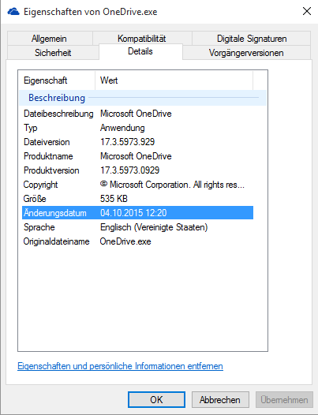
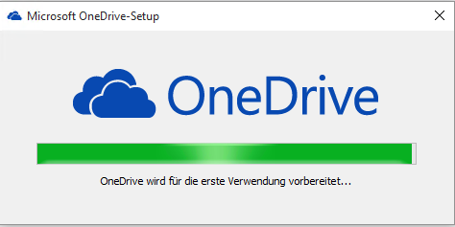
Next Generation Sync Client
Installation

Slide 27
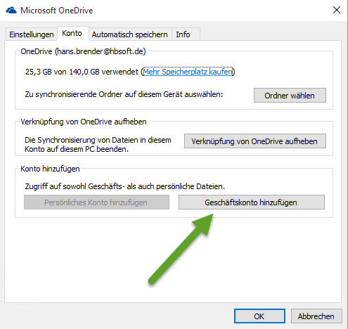
Next Generation Sync Client
Installation
Add business Account

Slide 28
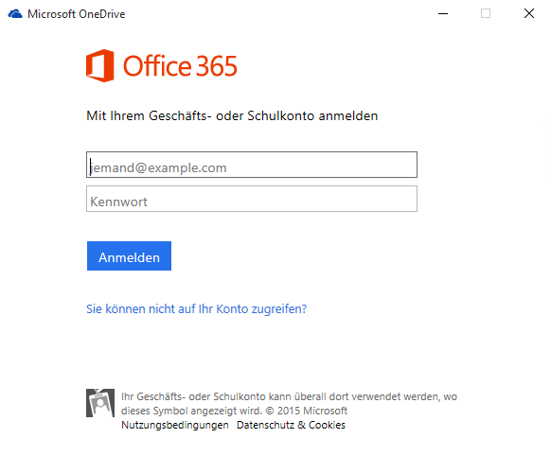
Next Generation Sync Client
Installation
Add business Account
Credentials

Slide 29
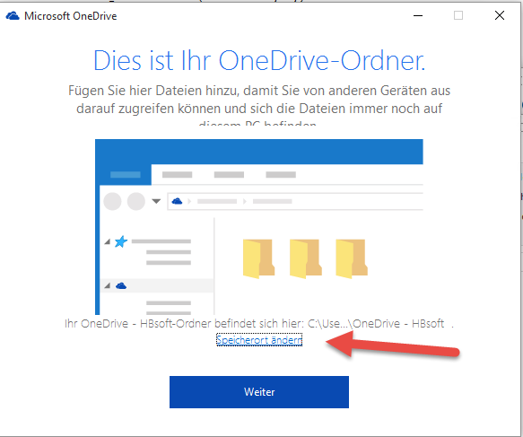
Next Generation Sync Client
Installation
Add business Account
Credentials
Location

Slide 30
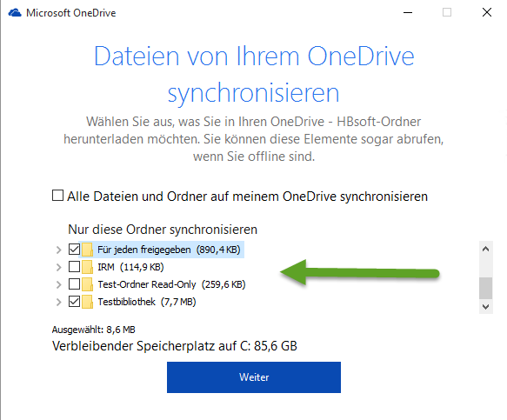
Next Generation Sync Client
Installation
Add business Account
Credentials
Location
Selective Synchronization

Slide 31
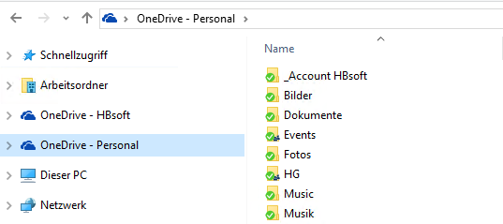
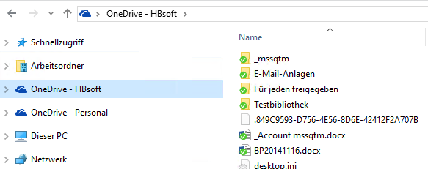
Next Generation Sync Client
Installation
Add business Account
Credentials
Location
Selective Synchronization
Explorer View

Slide 32
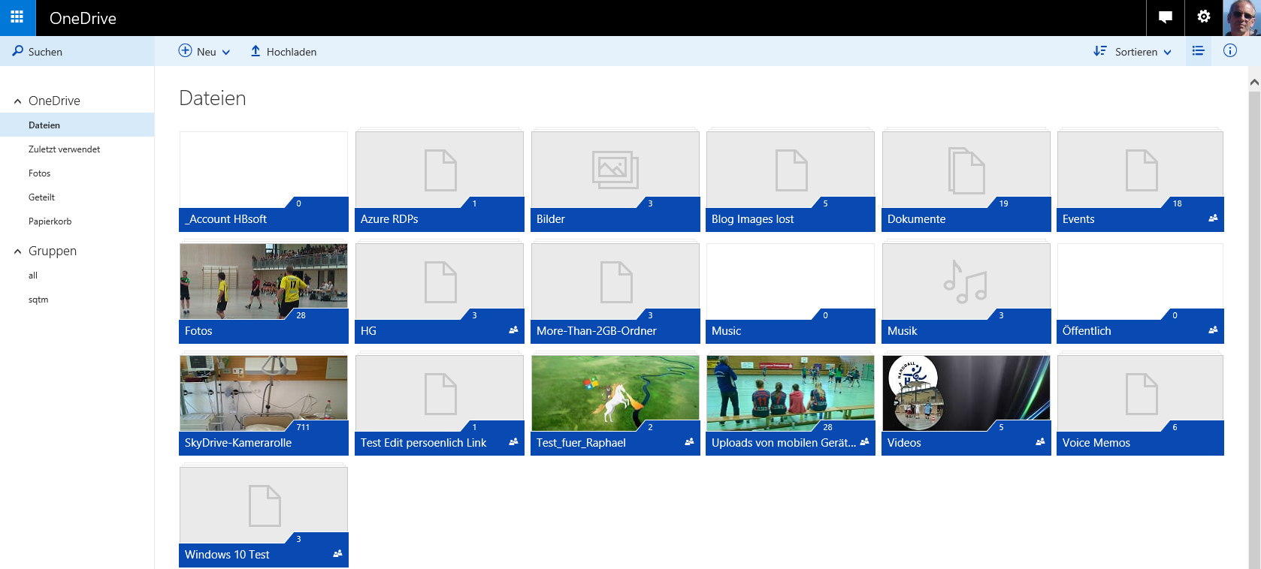
Next Generation Sync Client
Installation
Add business Account
Credentials
Location
Selective Synchronization
Explorer View
Browser View OneDrive

Slide 33
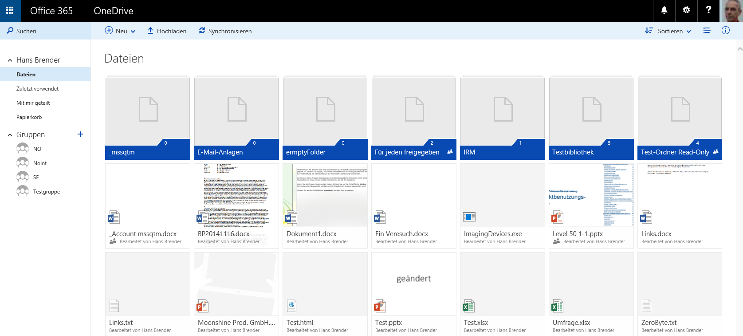
Next Generation Sync Client
Installation
Add business Account
Credentials
Location
Selective Synchronization
Explorer View
Browser View OneDrive
Browser View ODFB

Slide 34
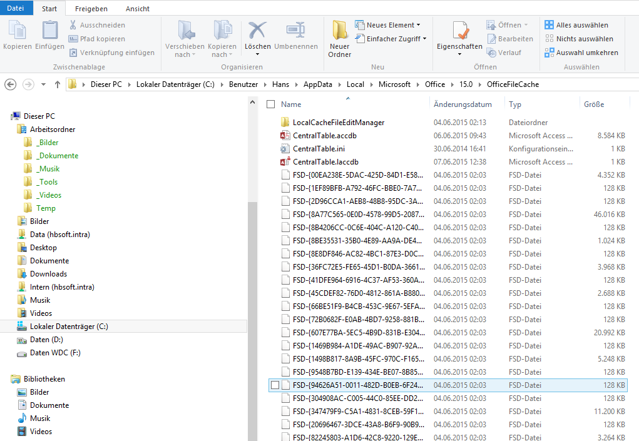

Next Generation Sync Client

Slide 35
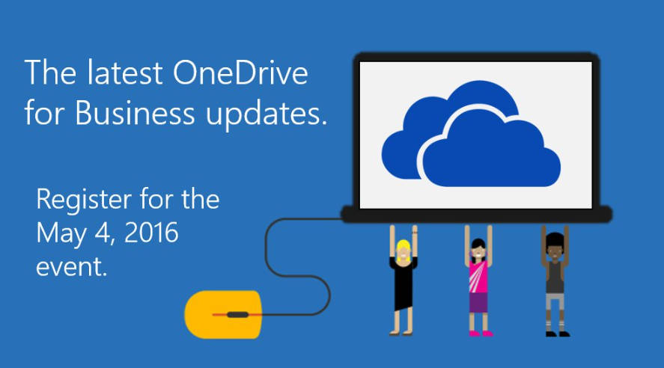
Next Generation Sync Client

Slide 36
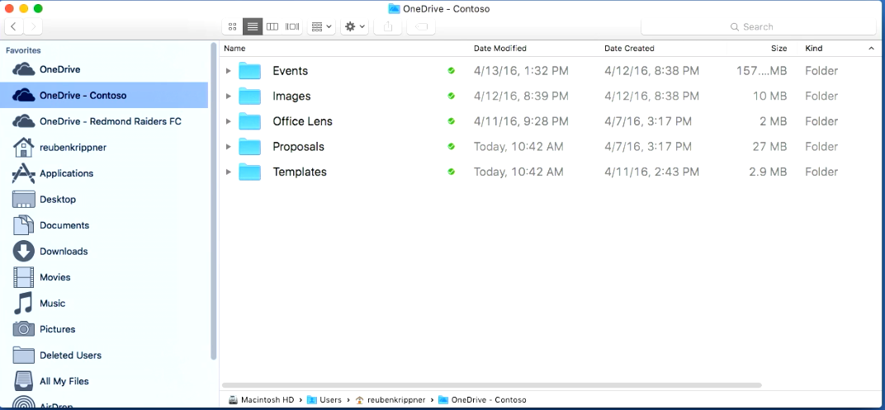
Next Generation Sync Client

Slide 37
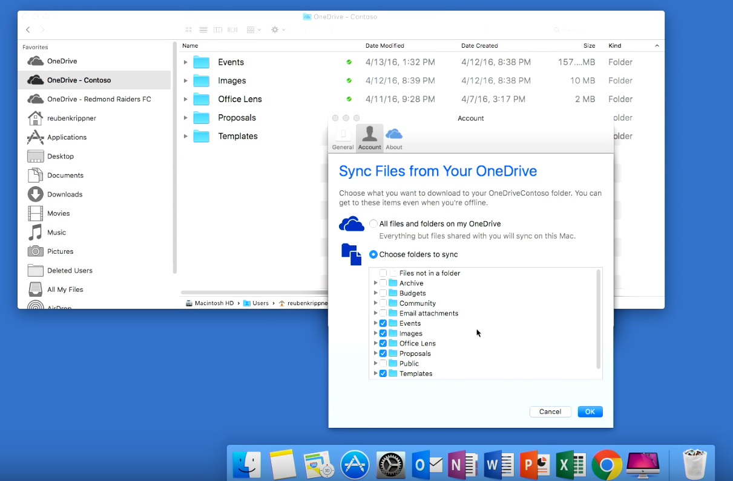
Next Generation Sync Client
MAC User Experience

Slide 38
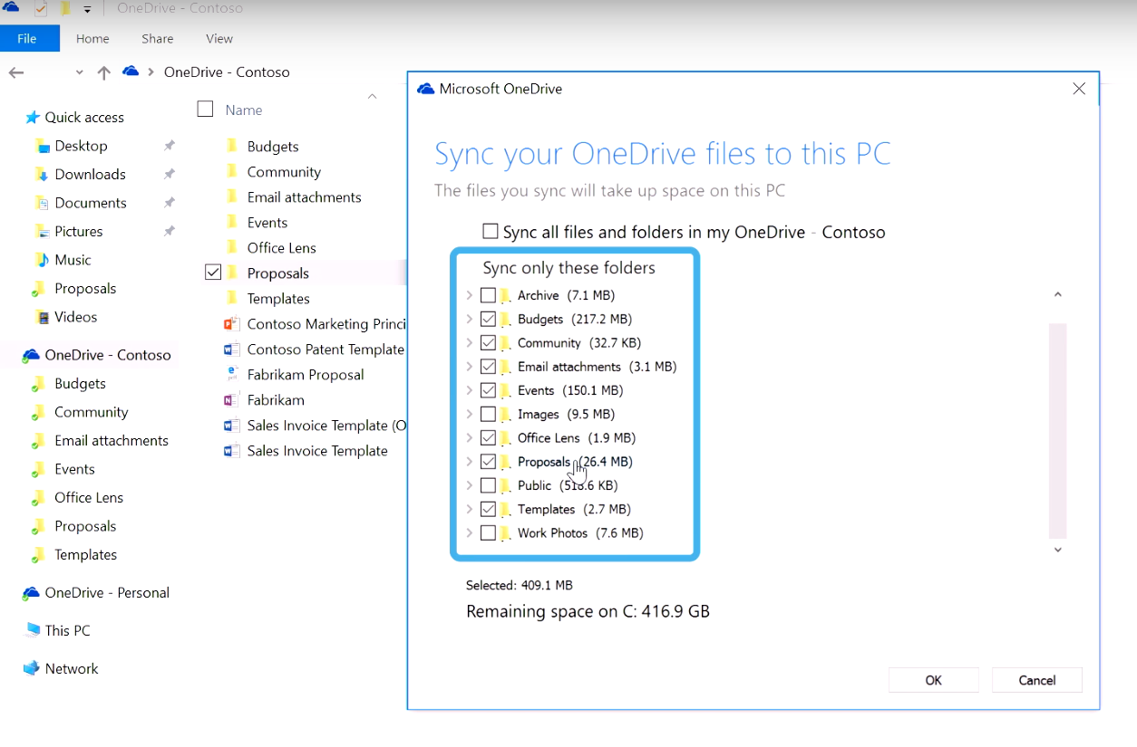
Next Generation Sync Client
Windows User Experience

Slide 39
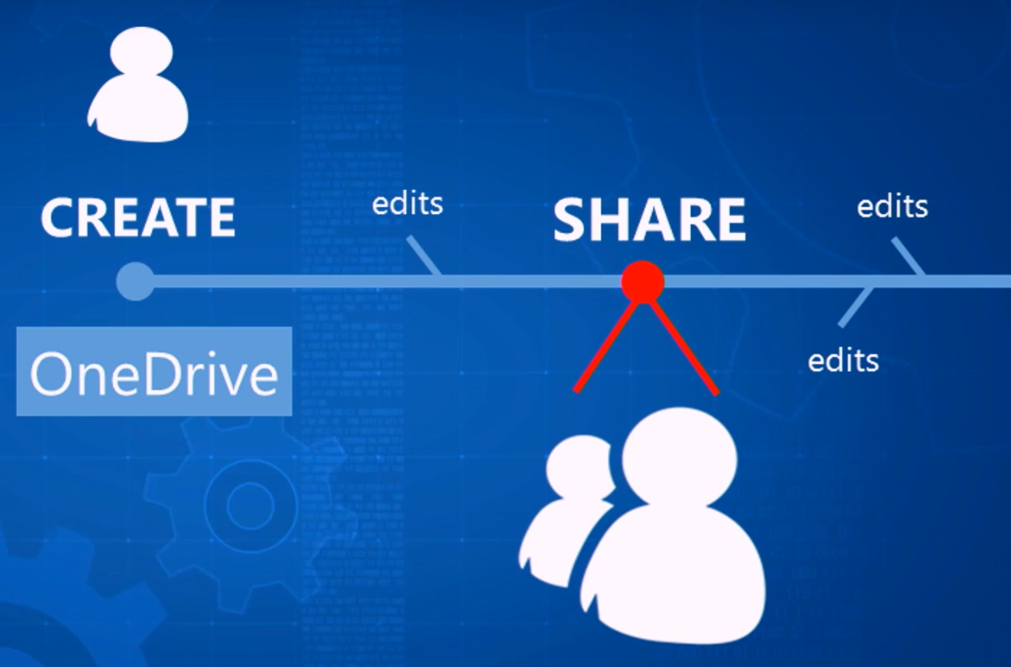
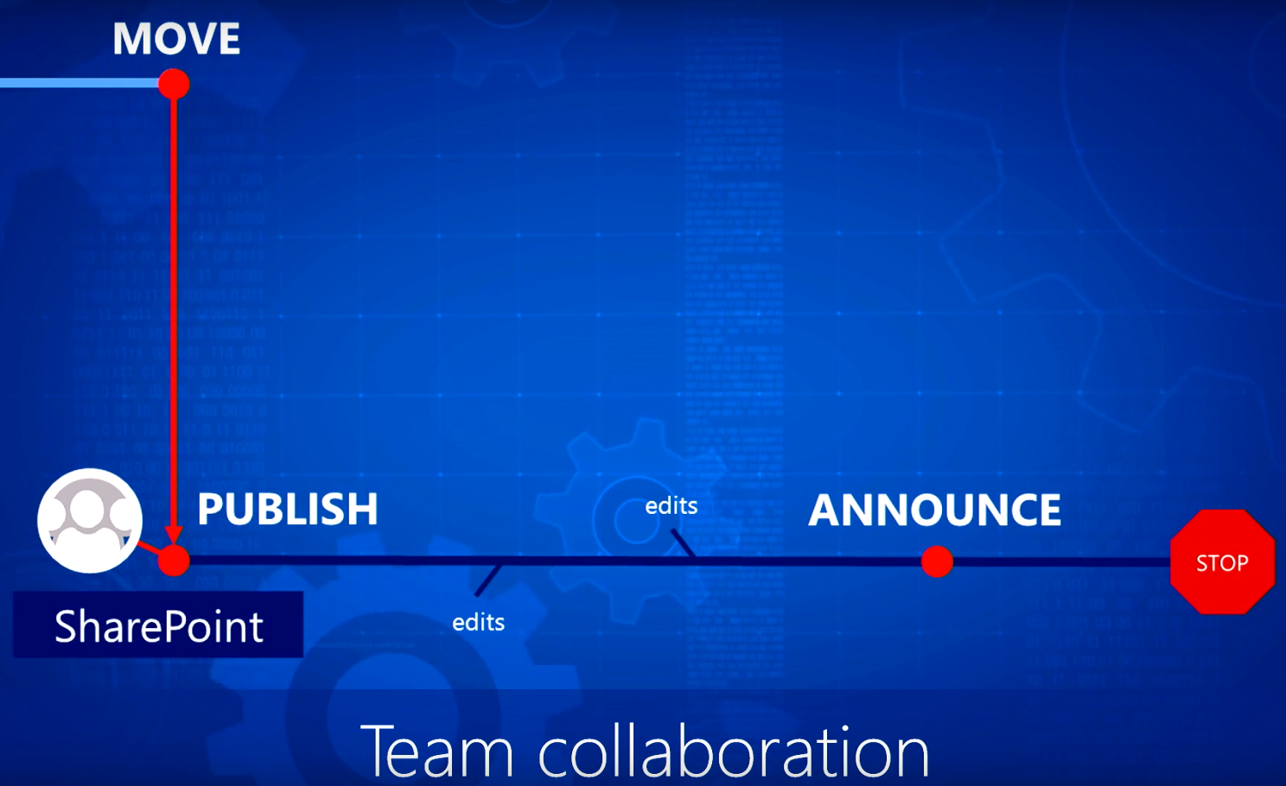
Next Generation Sync Client

Slide 40
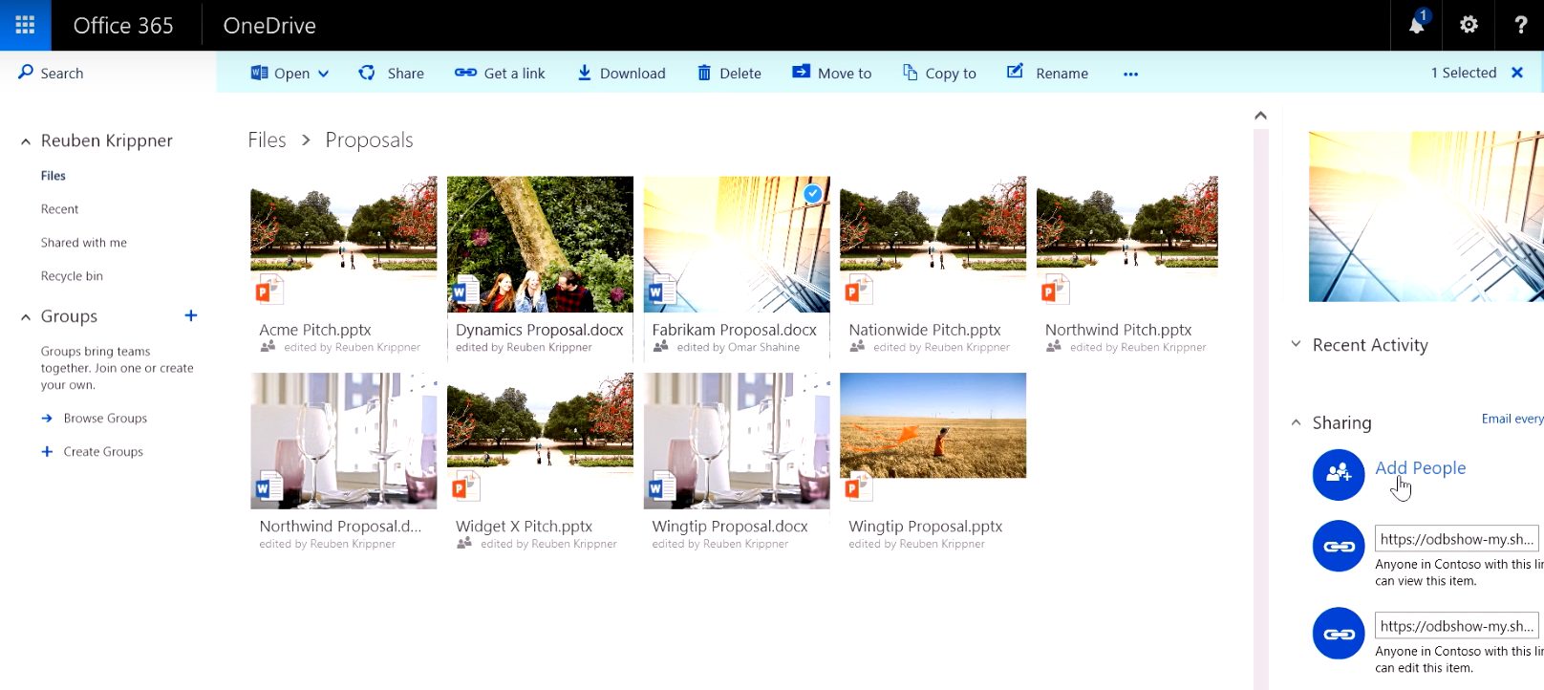
Next Generation Sync Client

Slide 41
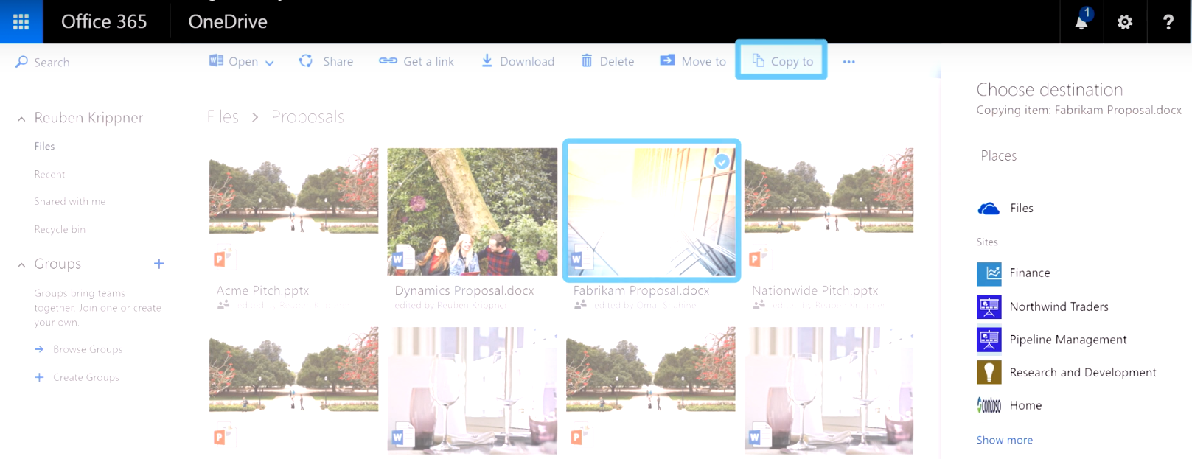
Next Generation Sync Client
Copy to SharePoint Team Sites

Slide 42
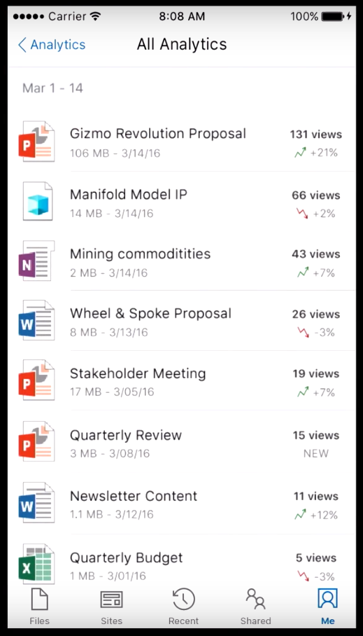
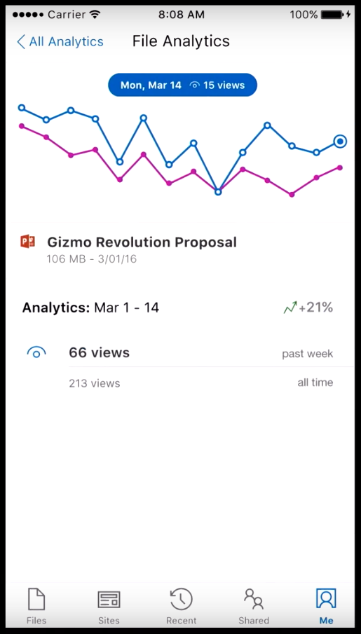
Next Generation Sync Client
+ Mobile Experience
+ Intelligence Experience
+ Analytics

Slide 43
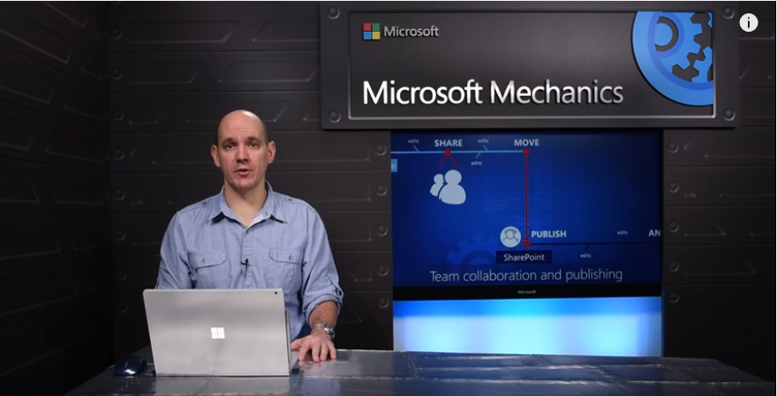
Next Generation Sync Client
Effortless File Sharing on any device: OneDrive for Business and SharePoint

Slide 44
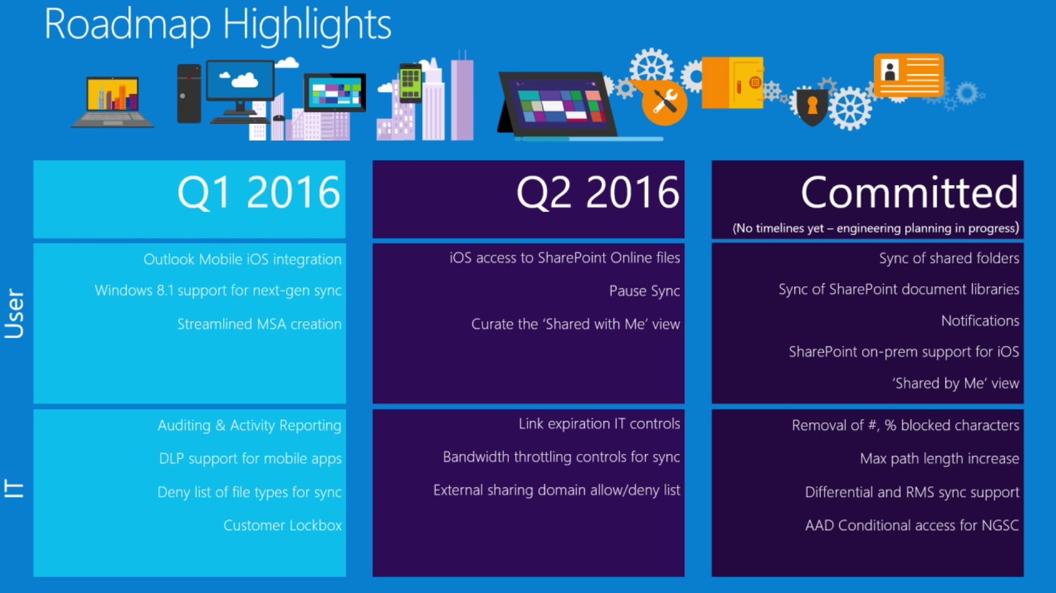
Next Generation Sync Client

Slide 45
Next Generation Sync Client
NGSC for Administrators
Deployment of Registry keys
Deployment and Installation without User action Automatic configuration to each User’s OneDrive for Business
Installation via GPO‘s or SCCM
Disable OneDrive (Personal)
Allow automatic Updates for the next generation Sync Client ( C2R)
Prevent, that a User could change the location of sync data …
…
Deploying the OneDrive for Business Next Generation Sync Client in an enterprise environment

Slide 46
Demo
Demo

Slide 47
Document Migration
Source
Destination
Box
File Server
SharePoint 2010 + 2013 SharePoint Online
DropBox
Google Drive
OneDrive for Business Azure Files
Box
SharePoint Online
Google Drive
OneDrive for Business
SharePoint 2013
Azure Files

Slide 48
Migration from File Server (User‘s Home-Drives) to OneDrive for Business
Before: Home-Drives, data saved on File Server
Goal: Home-Drives, Data save on OneDrive for Business
Example of a Telco-Company in Canada
Goal: 31.000 User’s
Upload-Speed: 2,5 h for 25 GB
Amount: 8 TB

Slide 49

FSConfig.csv Configuration
Users.csv Assignment File Servers Users path - Users
$$$$

Slide 50

Power Shell Script: Upload to Azure Blob Storage
$$$$

Slide 51

Power Shell Script: Creates a project in MigrationWiz
$$$$

Slide 52

Migration Read from Azure Blob storage
Write to OneDrive for Business
$$$$

Slide 53
Tenant Storage
1TB + (500MB * # of E/A/G users
1 TB each user
Still in Development (see Microsoft Roadmap) Storage and file upload improvements for Sites and OneDrive for Business
This update will bring two key enhancements for Sites in Office 365, videos uploaded into Office 365 Video, and OneDrive for Business. First, you will be able to upload files greater than 2GB - up to 10GB - to both Sites' document libraries and OneDrive for Business. We, too, will provide a greater amount of default storage for Office 365 Sites usage (for documents and information); Office 365 tenants will now get 1TB + (500MB * # of E/A/G users); this calculation used to be 10GB + (500MB * # of E/A/G users).
SharePoint Team Sites
Groups
OneDrive for Business
OneDrive
Personal

Slide 54
Filename restrictions
Still in Development (see Microsoft Roadmap) OneDrive for Business filename support improvements
We’re adding support for file names that contain ‘%’ or ‘#’ characters. Previously these were blocked for upload to OneDrive for Business. Additionally for all other blocked characters in filenames, OneDrive for Business will warn the user of a problem with their filename and provide them with the opportunity to rename the file to continue the upload. Finally, OneDrive for business will support filenames up to 256 characters in length. Together these changes will help users and organizations more easily adopt OneDrive for Business.
SharePoint Team Sites
Groups
OneDrive for Business
OneDrive
Personal

Slide 55
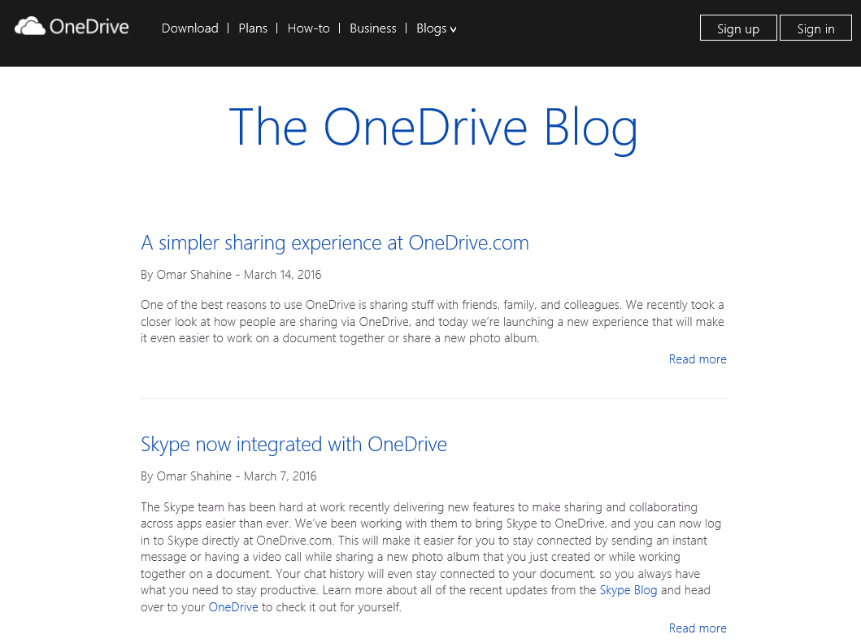
Recommendations
Read Blog Posts
Microsoft OneDrive Blog: http://blog.onedrive.com/
Hans Brender News: https://hansbrender.wordpress.com/
OneDrive http://bit.ly/1yBOz4f OneDrive for Business http://bit.ly/1SyzCbM
Next Generation Sync Client http://bit.ly/1FPACVG
Microsoft Office 365 Roadmap: http://roadmap.office.com/en-us/

Slide 56
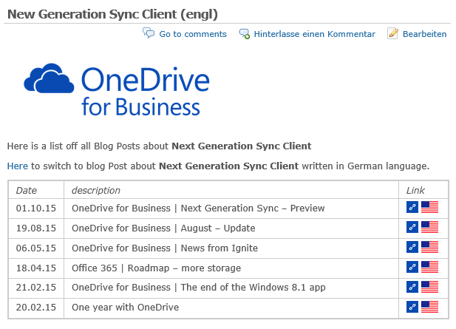
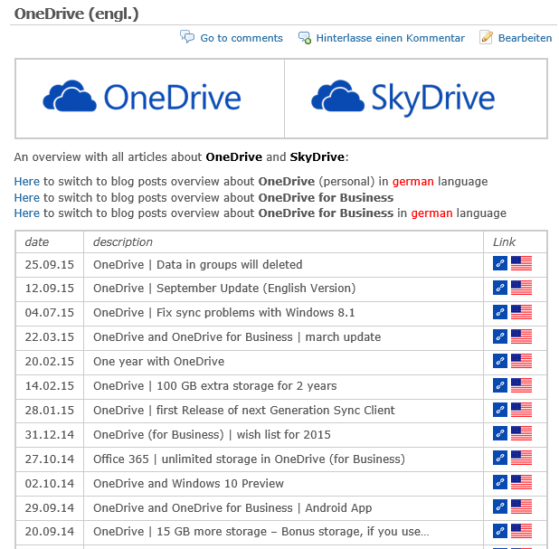
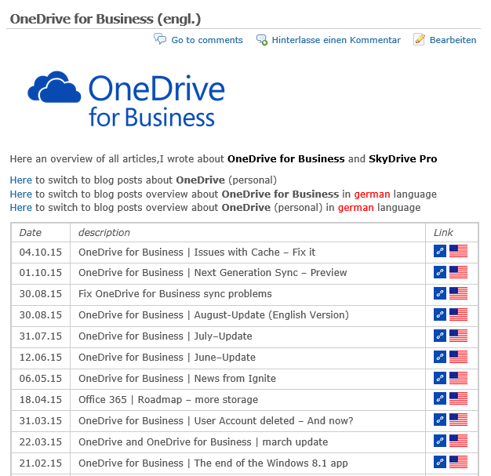
Recommendations
Read Blog Posts
Microsoft OneDrive Blog: http://blog.onedrive.com/
Hans Brender News: https://hansbrender.wordpress.com/
OneDrive http://bit.ly/DE-ODrive OneDrive for Business http://bit.ly/DE-ODFB
Next Generation Sync Client http://bit.ly/DE-NGSC
Microsoft Office 365 Roadmap: http://roadmap.office.com/en-us/

Slide 57
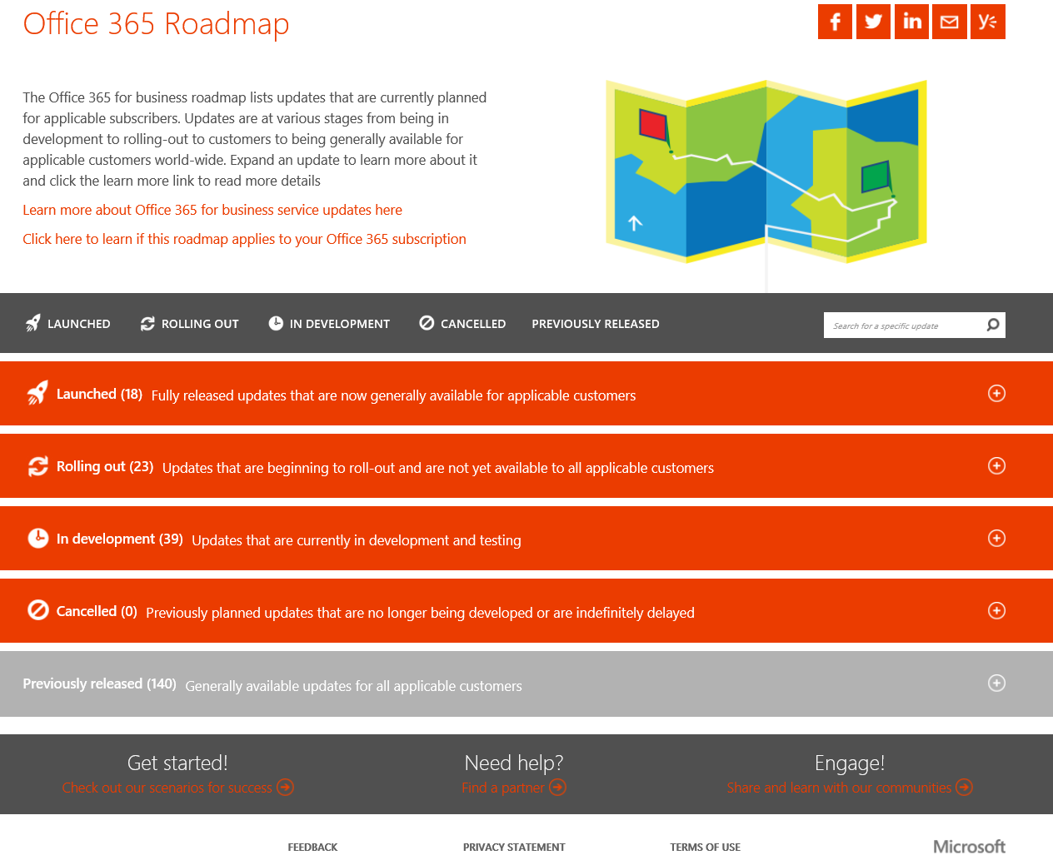
Recommendations
Read Blog Posts
Microsoft OneDrive Blog: http://blog.onedrive.com/
Hans Brender News: https://hansbrender.wordpress.com/
OneDrive http://bit.ly/DE-ODrive OneDrive for Business http://bit.ly/DE-ODFB
Next Generation Sync Client http://bit.ly/DE-NGSC
Microsoft Office 365 Roadmap: http://roadmap.office.com/en-us/

Slide 58
Recommendations
Read Blog Posts
Microsoft OneDrive Blog: http://blog.onedrive.com/
Hans Brender News: https://hansbrender.wordpress.com/
OneDrive http://bit.ly/DE-ODrive OneDrive for Business http://bit.ly/DE-ODFB
Next Generation Sync Client http://bit.ly/DE-NGSC
Microsoft Office 365 Roadmap: http://roadmap.office.com/en-us/
Next Generation Sync Client
Lernen Sie den OneDrive for Business-Synchronisierungsclient der nächsten Generation kennen
Deploying the OneDrive for Business Next Generation Sync Client in an enterprise environment
Transition from the existing OneDrive for Business sync client
Administrative settings for the OneDrive for Business Next Generation Sync Client
Which OneDrive sync client am I using?
Restrictions and limitations when you sync OneDrive for Business libraries through OneDrive for Business
Get started with the OneDrive for Business Next Generation Sync Client in Windows

Slide 59
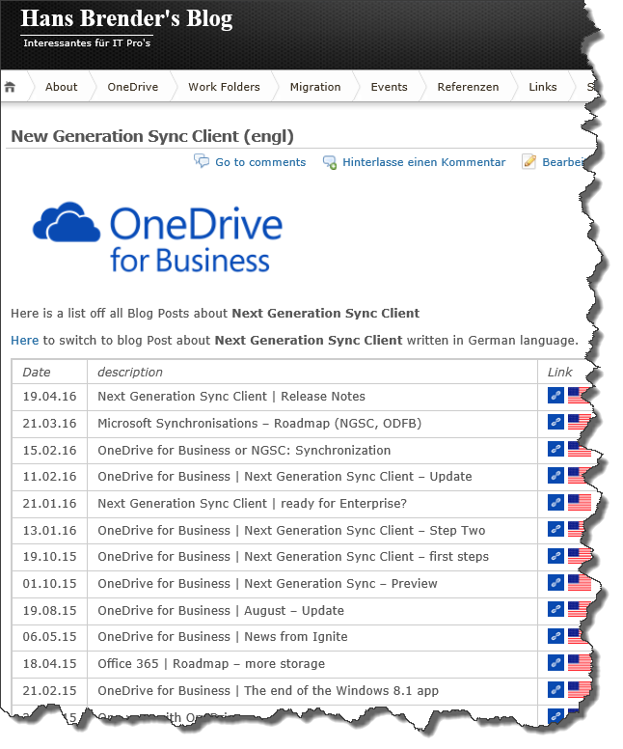


OneDrive?
OneDrive for Business?
NGSC?
questions
News about OneDrive ?
Blog: HansBrender.wordpress.com Follow Me on Twitter: @HansBrender
HBrender@BitTitan.com
Slides available: http://bit.ly/SPSMadrid16

Slide 60
Slides available: http://bit.ly/SPSMadrid16
Gracias
Gracias
Thank You
Thank you

Slide 61
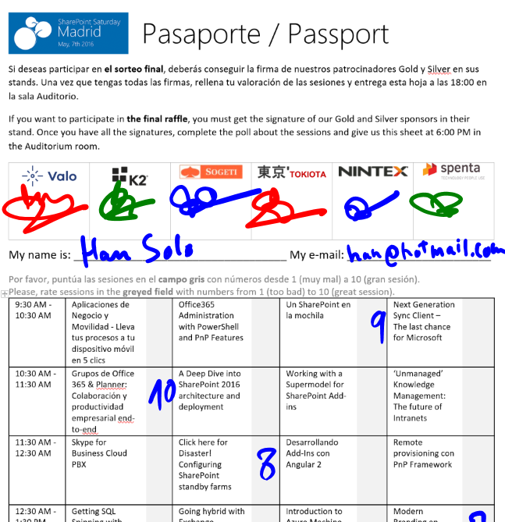

Raffle
Please, fill your SPS Madrid passport if you want to participate.
You must get signature from sponsors and complete the poll.
Give us the passport at 6:00 PM in the Auditorium room.
You can win one Sphero BB-8 or a mini drone:

